Slide 1
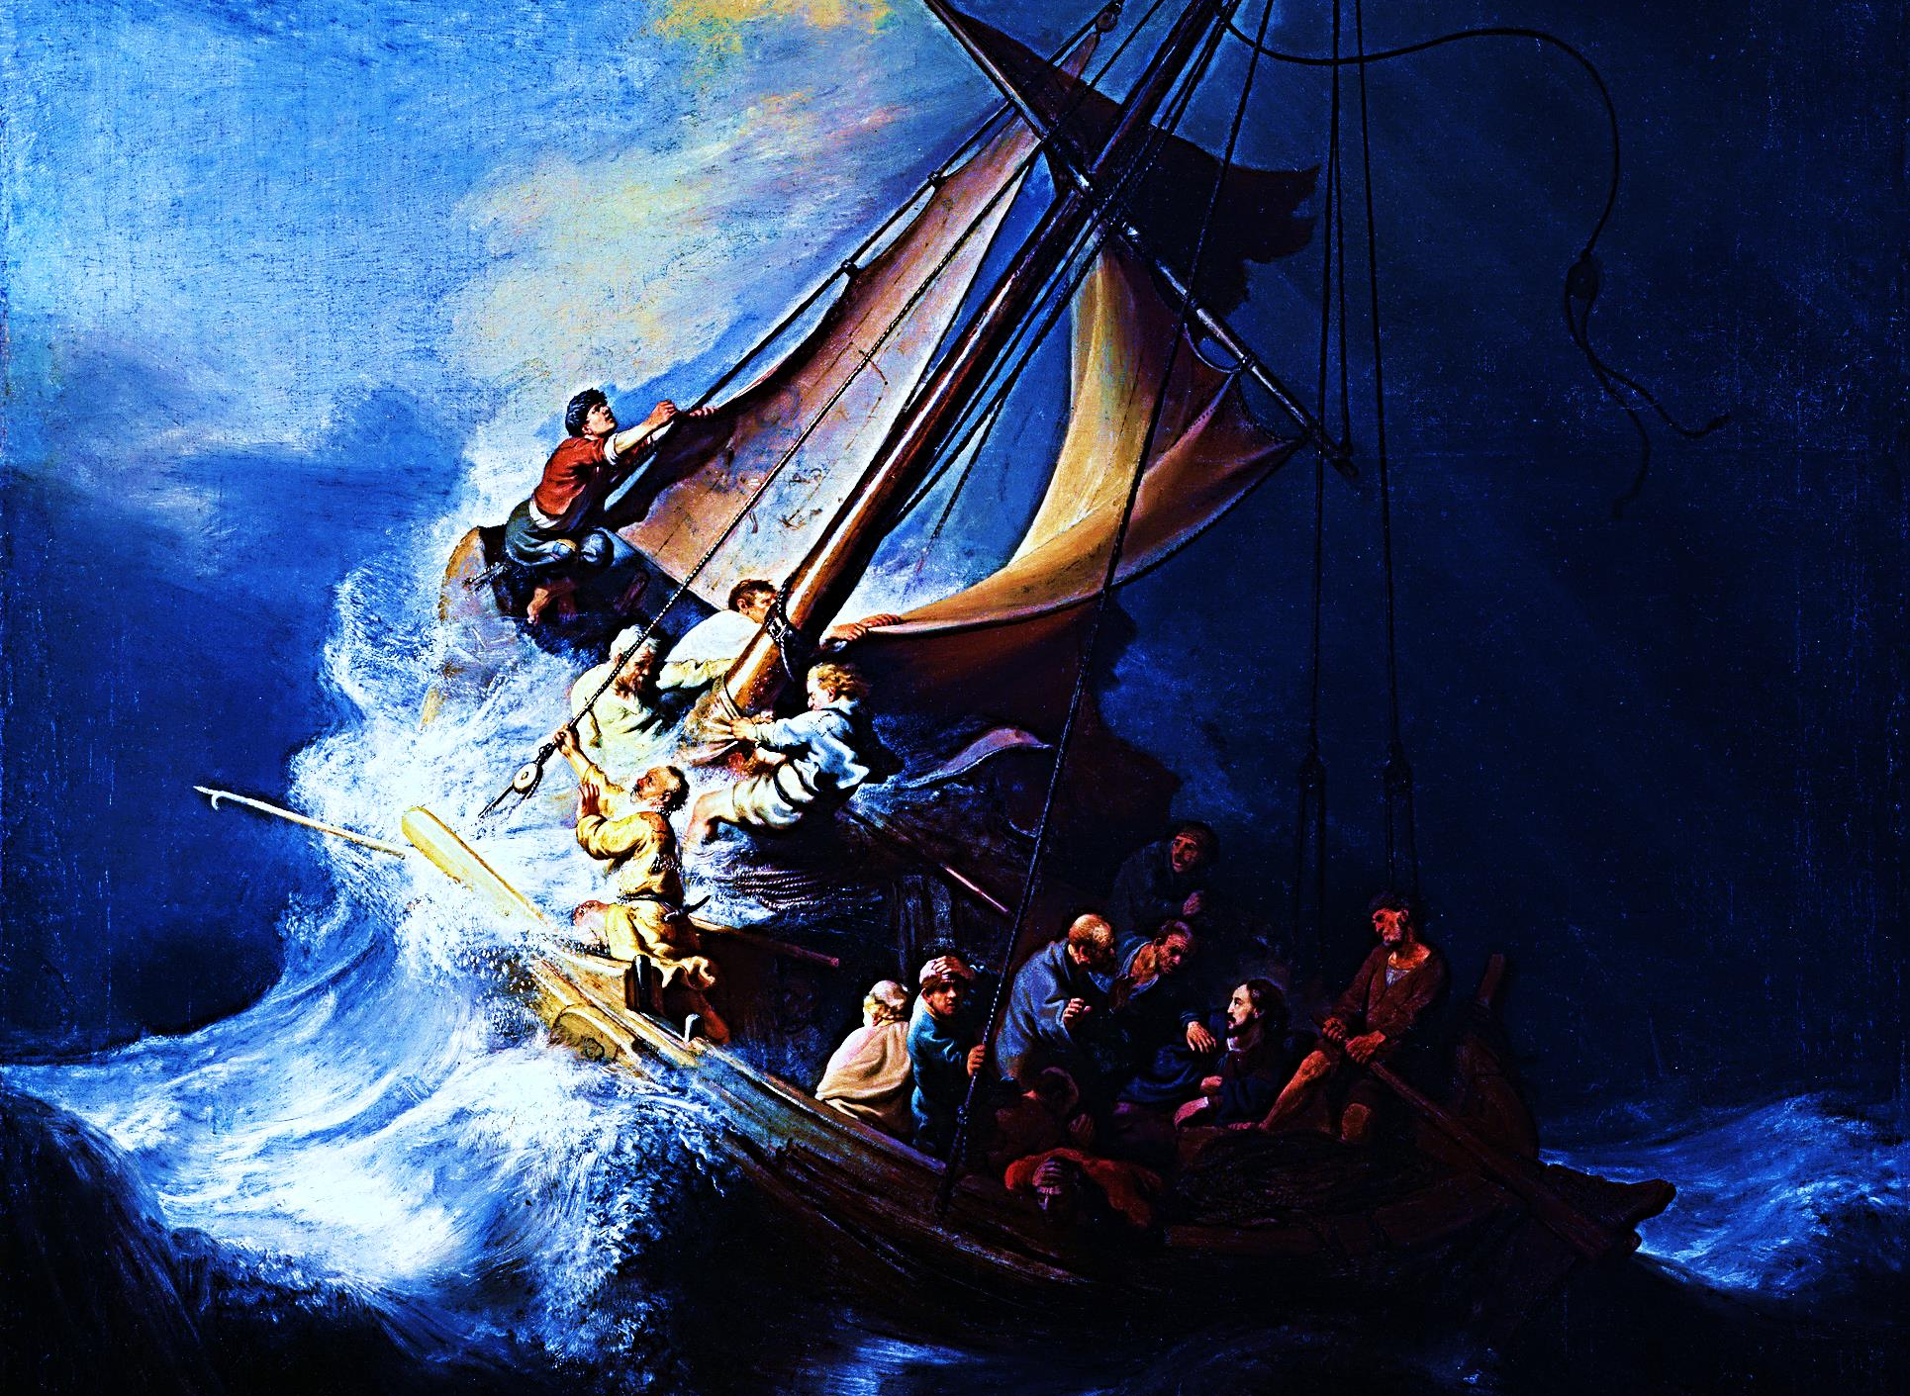
THE STORM STOPPER
Matthew 8:23-27, Luke 8:22-26

Slide 2
Note: Any videos in this presentation will only play online. After you download the slideshow, you will need to also download the videos from YouTube & add them back into your PowerPoint.
We present these messages at Bee Creek Park in College Station, TX. If you would like to watch the video of the service with this message, click here:
http://campaignkerusso.org/?p=10131
We would love to know more about the people who download our lessons & sermons. We invite you to email us & let us know where & how you use them.
info@ckbrazos.org

Slide 3
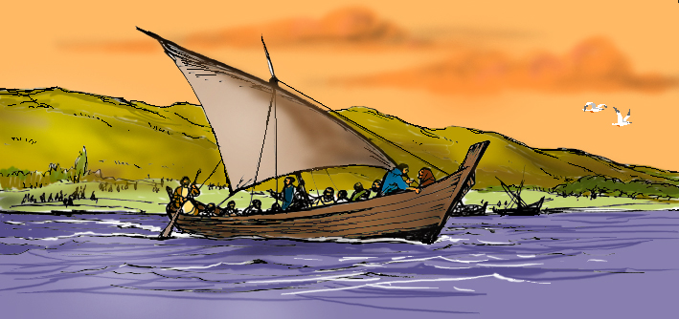
It had been a very long day. Jesus and his
Disciples needed to cross the sea of
Galilee to get home.

Slide 4
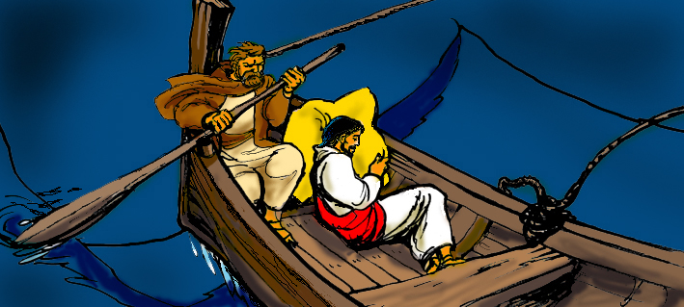
Jesus had a very busy day. He was tired.
He decided to sleep while they sailed
across the Sea of Galilee.

Slide 5
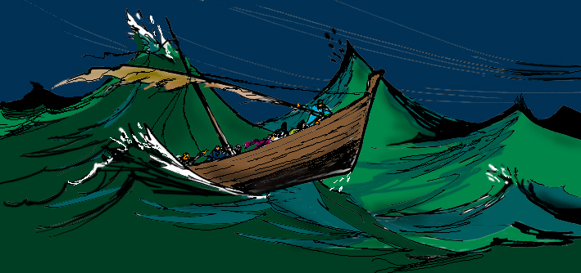
As Jesus slept a huge storm
began to blow up.

Slide 6
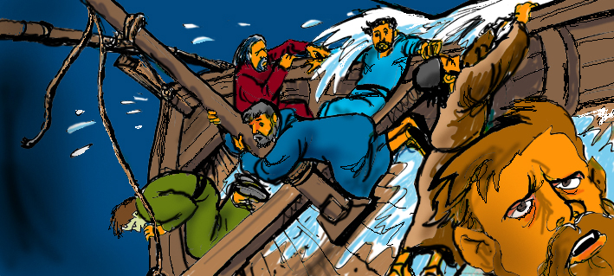
The waves grew higher and higher and the
boat began to fill with water

Slide 7
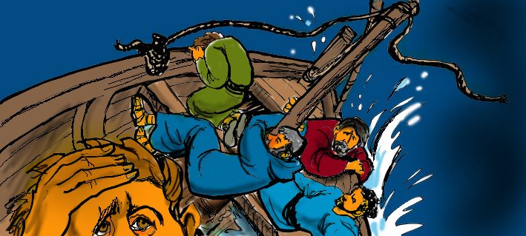
The Disciples were very scared.

Slide 8
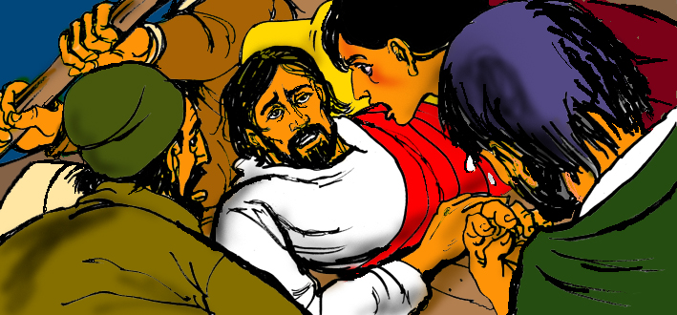
The Disciples woke Jesus and said
‘Help Us’.

Slide 9
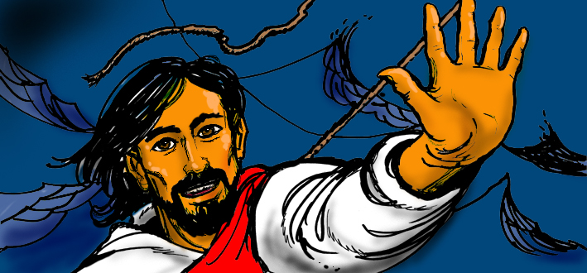
Jesus arose and told the wind to stop
blowing and the waves to be calm.

Slide 10
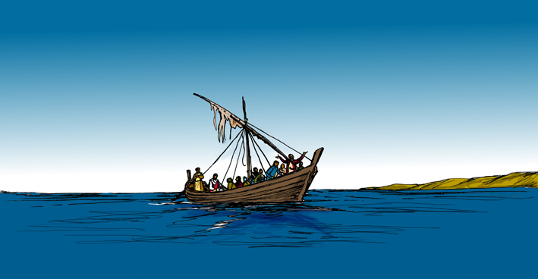
The Sea of Galilee was as smooth as glass.

Slide 11
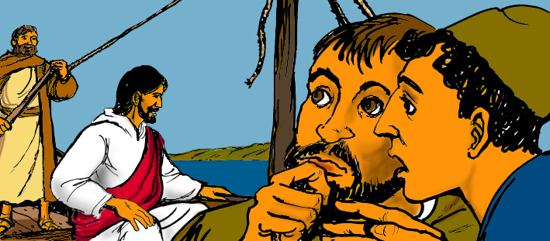
Then Jesus turned to his disciples and said
“why were you afraid?”

Slide 12
Think about…
Questions to Think About
Why do you think the disciples were afraid?
Did you think that Jesus would save them?
Can you think of a time when you were scared?
Who looks after you when you are scared?

Slide 13
Next Slide → Song: “Sometimes He calms the Storm” Download Here: http://youtu.be/pCBU1OKkkyM

Slide 14
Note: Any videos in this presentation will only play online. After you download the slideshow, you will need to also download the videos from YouTube & add them back into your PowerPoint.
We present these messages at Bee Creek Park in College Station, TX. If you would like to watch the video of the service with this message, click here:
http://campaignkerusso.org/?p=9369
We would love to know more about the people who download our lessons & sermons. We invite you to email us & let us know where & how you use them.
info@ckbrazos.org

Slide 15
What is the Sinner‘s Prayer?
This is a prayer we can pray when we are ready to admit we are sinners and need Christ’s forgiveness.
It must be prayed with faith in our hearts and a readiness to have a life-changing encounter with Jesus Christ.

Slide 17
John Wesley’s Testimony
“…the preacher was describing the change which God works in the heart through faith in Christ and I felt my heart strangely warmed.”
Disciple’s Testimony
“They said to each other, ‘Did not our hearts burn within us while he talked to us on the road, while he opened to us the Scriptures?’”

Slide 18
A prayer of faith → Pray this prayer if :
If you never have before
You have in the past, but you think it would mean more today
You have been walking afar off and you want to come back
You want to set an example & show others how it is done
You just like to give your heart to Jesus again & again
Faith

Slide 19
We Declare Our Faith Publicly Because Jesus Declared His LOVE Publicly
“If you stand before others and are willing to say you believe in me, then I will tell my Father in heaven that you belong to me.” Mat 10:32

Slide 20
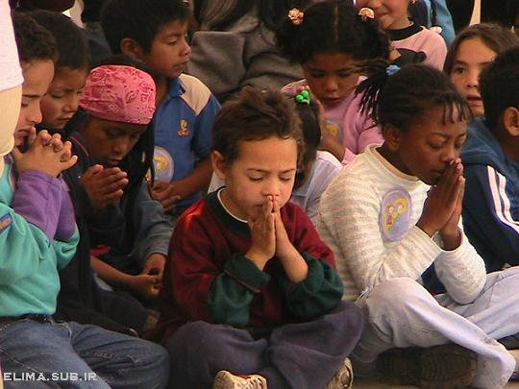
Dear Jesus,
I know I am a sinner & need your forgiveness.
I believe you died for my sins.
I now turn from sin.
Come into my heart I pray.
Do you want to meet Jesus as your savior right now?
Do you believe He died to save you from your sins & that He rose from the dead?
Do you believe that He is waiting to save you right now?

Slide 21
“But some people did accept him. They believed in him, and he gave them the right to become children of God.” John 1:12

Slide 23
“If you openly say, ‘Jesus is Lord’ and believe in your heart that God raised him from death, you will be saved.”
Rom. 10:9
What did you learn today?
What is the meaning of the name-tag?
What have you neen thinking about God lately?
What do you want to tell the world about Jesus?

Slide 24
“Draw near to God, and He will draw near to you…
…Cleanse your hands, you sinners, and make your hearts pure, you who are half-hearted towards God.” James 4:8 WNT

Slide 25
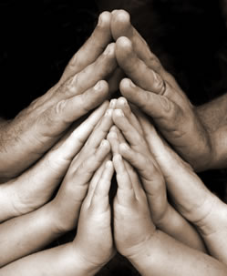
Close in Prayer

Slide 26
Note: Any videos in this presentation will only play online. After you download the slideshow, you will need to also download the videos from YouTube & add them back into your PowerPoint.
We present these messages at Bee Creek Park in College Station, TX. If you would like to watch the video of the service with this message, click here:
http://campaignkerusso.org/?p=10131
We would love to know more about the people who download our lessons & sermons. We invite you to email us & let us know where & how you use them.
info@ckbrazos.org

Slide 27
Welcome to Aggieland Faith Family Style Worship

Slide 28
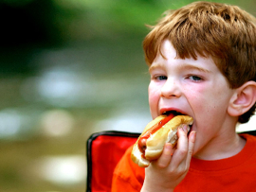
CURRENT SCHEDULE: See www.Aggielandfaith.org
SATURDAY —
At Bee Creek Park
2:00-4:00pm: Through the bible with felt-board stories – plus hot-dogs & drinks
SUNDAY —
At Bee Creek Park
2:00-4pm: Free snacks, drinks, kids crafts, prizes, singing & bible preaching

Slide 29
Would You Like Prayer or Bible Study at Your House?
Personal Prayer: We can come to your home & pray with you, or you can email us when you need prayer.
Home Bible Study: We will come to your home & hold a bible study for you & your friends.
Bible Party: We will hold a Kid’s Bible Party: You provide the food & kids - we will do the bible fun & stories.

Slide 30
Would You Like Visitation?
We will visit a friend, loved one in the hospital or in prison to pray for them & share Christ with them.
Contact: info@aggielandfaith.org

Slide 31
www.aggielandfaith.org
Go here to see pictures & videos
Go here to subscribe to e-mails about changes & cancellations

Slide 32
Note: Any videos in this presentation will only play online. After you download the slideshow, you will need to also download the videos from YouTube & add them back into your PowerPoint.
We present these messages at Bee Creek Park in College Station, TX. If you would like to watch the video of the service with this message, click here:
http://campaignkerusso.org/?p=10131
We would love to know more about the people who download our lessons & sermons. We invite you to email us & let us know where & how you use them.
info@ckbrazos.org

